Slide 1

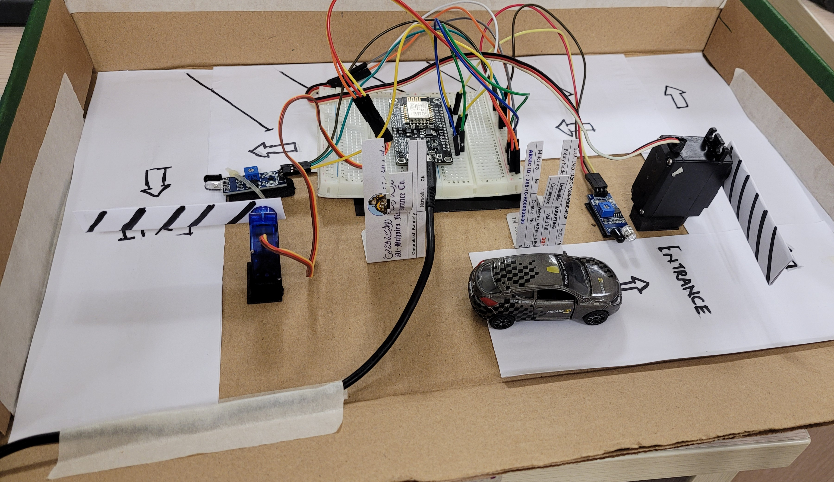
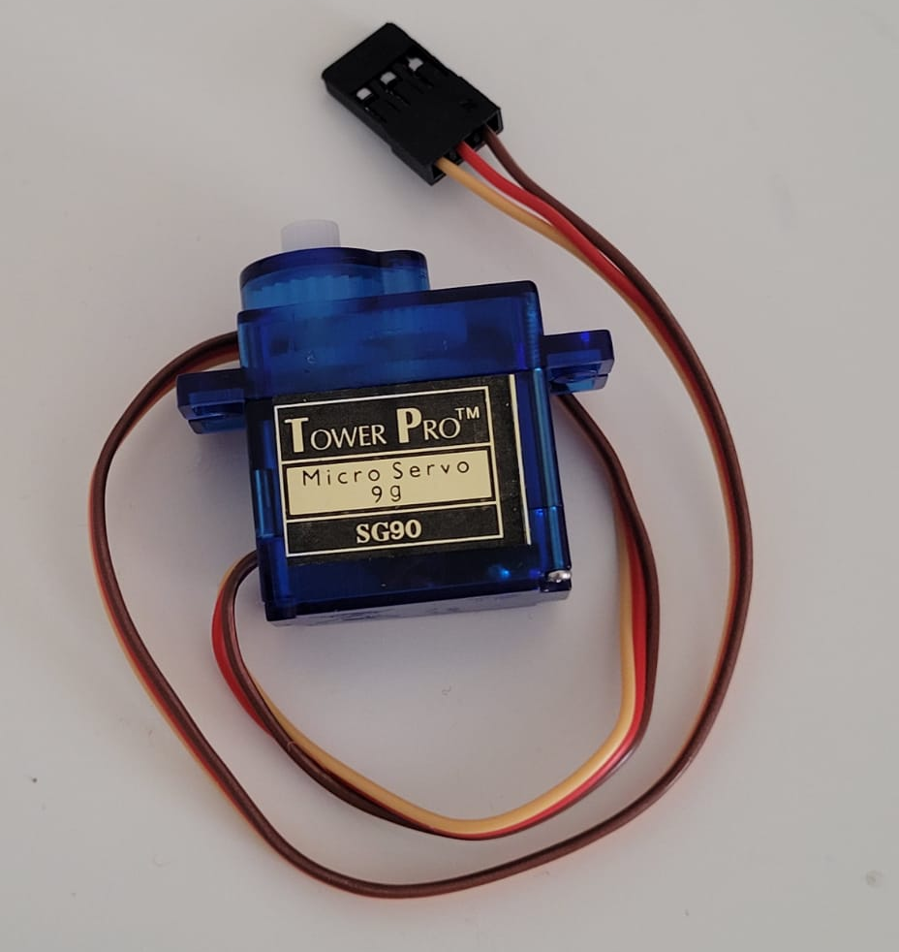
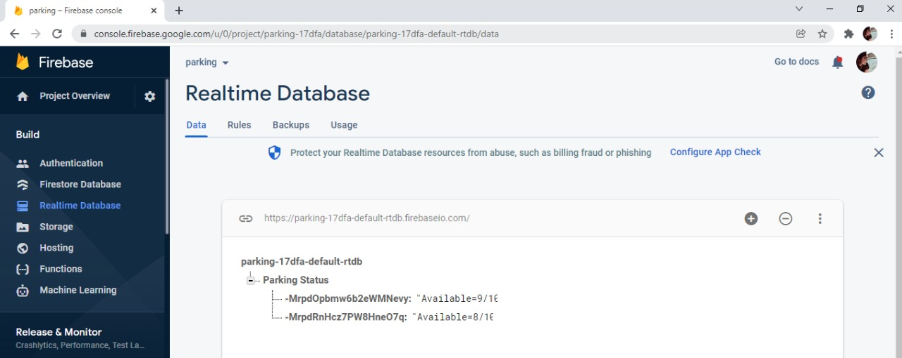
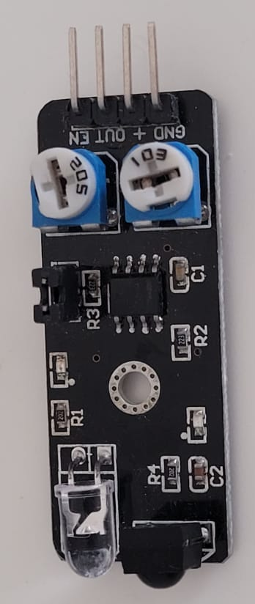
IOT BASED SMART PARKING SYSTEM
Anamika Kannoly; Mayur Devadiga; Prithvika Babu; Samiksha Arun
Manipal Academy of a Higher Education, Dubai
ABSTRACT
INTRODUCTION
WORKING
CONCLUSIONS
With the rising popularity of Smart Cities, smart solutions for all domains are always in demand. In a smart city, there are many domains, and one of the most prominent domains remains that of Smart Parking.
Nowadays, obtaining parking in congested places is quite difficult, and there is no mechanism in such kind of places to obtain information about parking availability online. Imagine being able to obtain information on parking spot availability simply by glancing at a board. The IoT-based smart parking system can overcome this problem.
The suggested parking system is based on Internet of Things (IoT) technology and is designed to be low-cost, effective, and efficient. The main goal is to aid or assist cars in finding an empty parking spot. In addition, the suggested parking system can store the number of parking spaces in a database.
In this IOT based Smart car parking system, we integrate NodeMCU which is the most popular controller to build IoT-based applications as it has inbuilt support for Wi-Fi to connect to the internet.
The microcontroller along with two IR sensors, an ultrasonic sensor, and an LCD display is used. The ultrasonic sensor may be used to measure the distance between different objects. It utilizes two IR sensors that automatically detect if a car is there or not as it enters a parking space, and the LCD screen subsequently displays the available parking space to the driver.
Furthermore, it also helps the drivers in reducing their time spent in finding vacant parking slots. As such, the drivers save their energy and will help reduce the traffic congestion in the parking area. Here we are using firebase as the IoT database to get the number of parking spaces available.
The programming for NodeMCU is done using the Arduino IDE. Open the IDE and import the necessary libraries for working the NodeMCU.
We import the library ‘FirebaseArduino.h’ to be able to work with the integrated database.
Next, we have to include the firebase credentials as the Hostname/project name and the secret key.
We must also enter the Wi-Fi credentials as Wi-Fi SSID and Password to establish connection to the Wi-Fi network.
Next, we initialize the two servo motors used for the entry and exit gate. Servo motors of the entry and exit gate are then to be connected to the NodeMCU pins (D5 and D6 pins are used).
Coming to the IR sensor, we must connect two of these sensors to two NodeMCU pins (D0 and D4 pins). These sensors are used to detect the entry and exit of the car at their respective gates.
Next, we establish connection to Wi-Fi, after which, we can connect to Firebase using the Hostname and secret key.
Digitally read IR sensor pin as the entry sensor and check if it is high. If so, increment the entry counter.
As per the output from IR sensor, move the servo motor by an appropriate angle in order to open the entry gate.
Now send the value to Firebase with pushString which is the Firebase library function.
Implement the same steps for the Exit IR sensor and motor.
Update the Firebase by adding the number of cars entered and subtracting the number of cars exited.
The suggested parking system prototype was created to visualize and stimulate the real parking system environment, and a demo of the prototype revealed the system's capacity to reserve the exact position of the parking spot by showing it on the LCD screen.
As a result, the suggested parking system can benefit drivers all while encouraging other developers to contribute to future initiatives that would assist vehicles in readily locating an available parking place.
Because it is cost-effective and simple to execute, the suggested strategy outperforms current framework approaches. This can also keep track of the overall number of vehicles on a given day, which may be utilized for further traffic research.
COMPONENTS
REFERENCES
The following components are used in the Smart parking system:
ESP8266 NodeMCU board
Ultrasonic sensor
DC Servo Motor
Two IR sensors
16x2 i2c LCD Display
Jumpers
Breadboard
https://iopscience.iop.org/article/10.1088/1742-6596/1424/1/012021/pdf
https://circuitdigest.com/microcontroller-projects/iot-based-smart-parking-system-using-nodemcu
https://www.researchgate.net/publication/350489759_IoT_based_Car_Parking_Management_System_using_IR_Sensor
Figure 1. Lateral view of Smart Parking Prototype
Figure 2. Component- Servo Motor
Figure 3. Component- IR sensor
Figure 4. Firebase- Realtime Database

